Slide 1
Group 7: Robotic Blackjack Dealer
Kyle Cullen, Nicholas Lowe, Curtis Maher, Luca Mahoney

Slide 2
The Problem and Our Solution
The Business Problem: Reliable, human dealers are costly for casinos, particularly smaller establishments. It can become even more costly to fill all the tables a casino might want to run.
The Customer Problem: Players can also feel uncomfortable with an experienced dealer, or think that they are manipulating cards for a house advantage.
Our Solution: This Robotic Blackjack Dealer is being designed to provide users with an interactive experience of playing Blackjack. It combines the tangibility of playing in real life with the ease of automation found in online games.
Replacing some live dealers with robotic dealers will cut on casino expenses, allow for more players to be hosted, and will allow for a better established trust that there is no cheating or manipulation

Slide 3
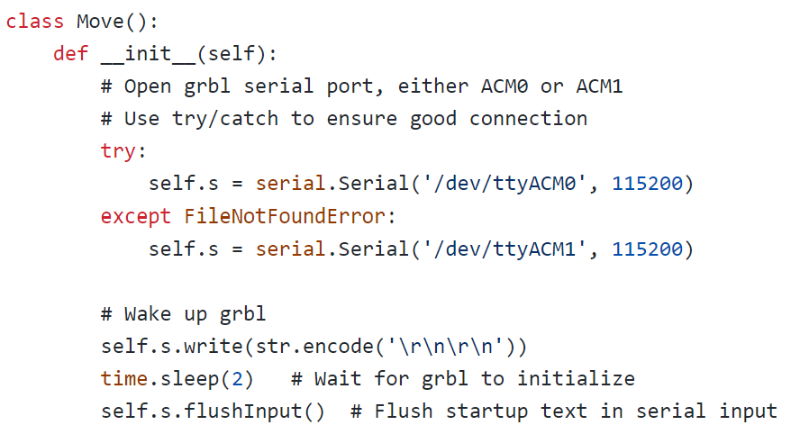
How We Move
With the Move() class.
Contains 4 functions that stream commands to the Arduino Uno.
setG: Sends a list of settings on power up.
draw: Take a card from the draw pile, drop it off for a picture.
place: Pick a card up from one set of coordinates and drop it off at any other set of coordinates.
discard: Iterate through a stack of coordinates of every card location played and move them to the discard location.

Slide 4
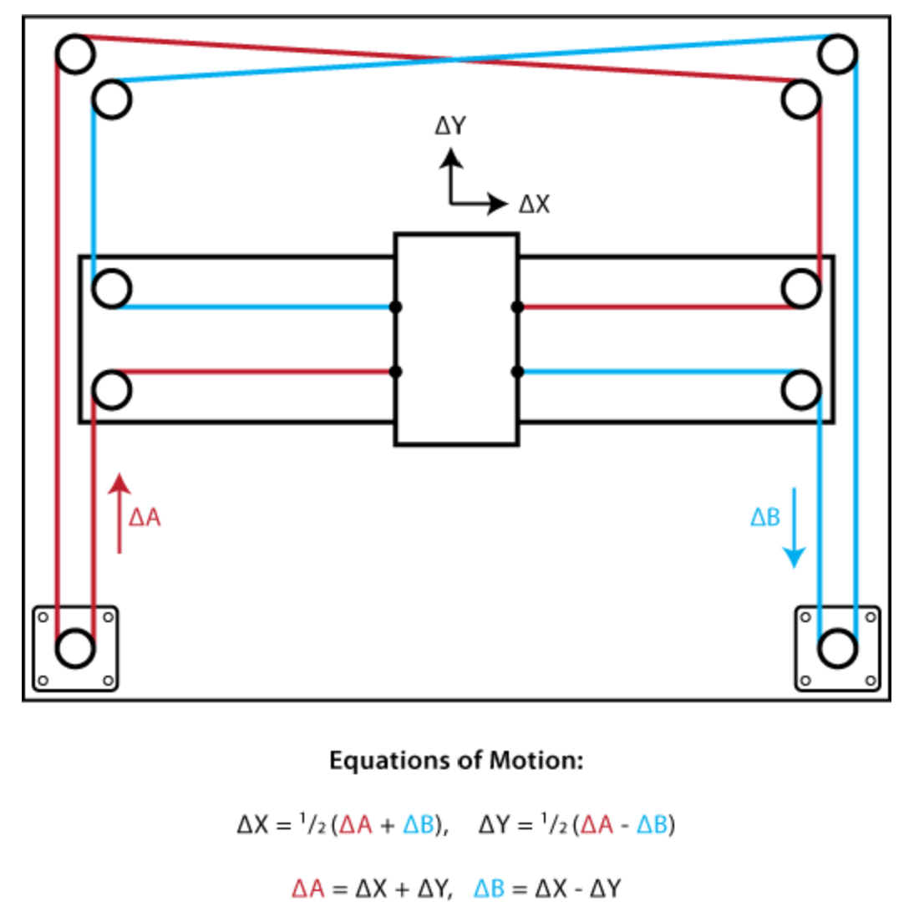
Gantry and Motor Performance
Expectation: Complete a deal with one minute for each player, including the dealer, plus one additional minute.
Reality:
Trial | Deal Time | No. of Players
1 | 2:11* | 2
2 | 1:57 | 2
3 | 1:59 | 2
4 | 2:54 | 3
5 | 4:00 | 4
Figure from http://corexy.com/theory.html

Slide 5
Repeatability
Trial | Theta | Displacement | Vac Success
1 | 3 | <0.125” | Y
2 | 7 | <0.125” | Y
3 | 11 | <0.125” | Y
4 | 14 | <0.25” | Y
5 | 18 | <0.25” | Y
6 | 22 | <0.125” | Y
7 | 23 | <0.25” | Y
8 | 27 | <0.25” | Y
9 | 30 | <0.25” | Y
10 | 34 | <0.25” | Y
A metric I did not initially consider is card twisting, but it has become a problem to manage (<10 degrees/move).
Displacement in the xy plane was set to <0.5”. This metric is most important for proper discarding.
Collected data was cumulative, assuming card started at 0 degrees and 0” displacement.

Slide 6
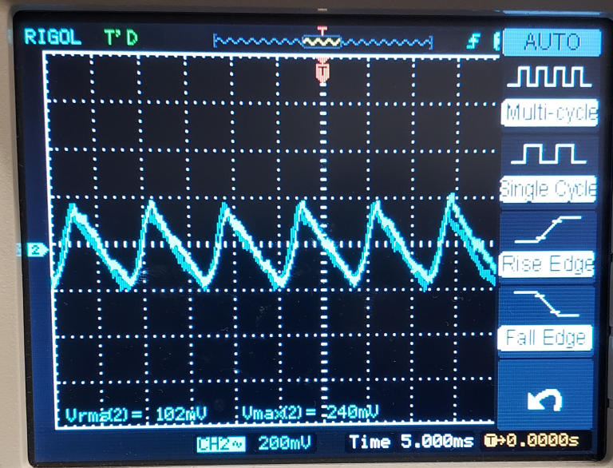
Power System
Designed AC-DC conversion circuit for powering systems
115V/20V center tapped transformer.
600V/25A rectifier.
Very low output ripple.
Max current of 5A
Voltage circuits
5V-1A: Vacuum Pump, ring lights.
5V-3A: Raspberry Pi.
12V-1A: Fan
20V-5A (main power): Motors

Slide 7
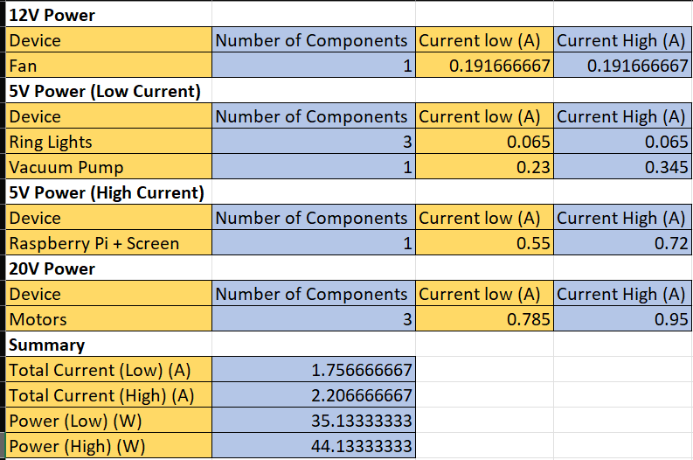
Current Draw/Power Consumption
Expected current draw between 1.76 and 2.21A.
Expected power dissipation of around 35-44W.
Some dissipation (heat) losses on 12V regulator.

Slide 8
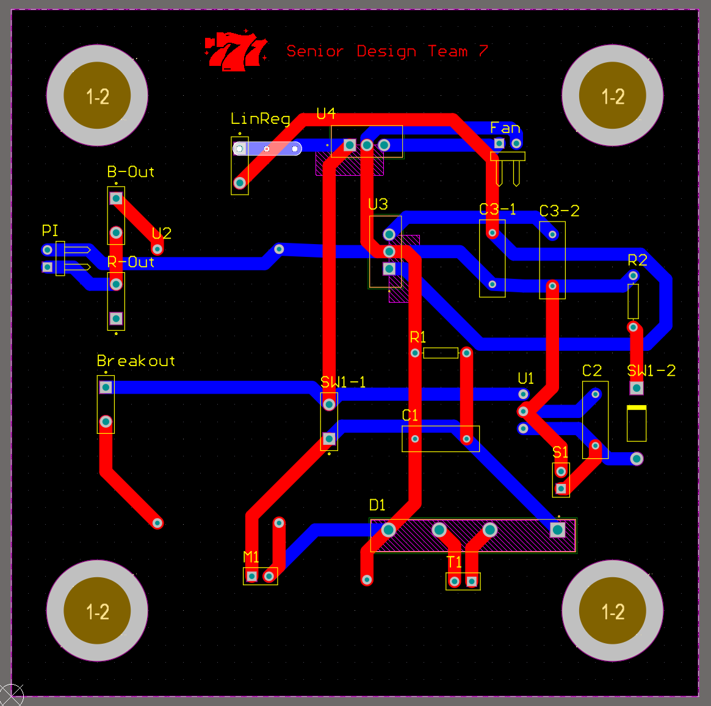
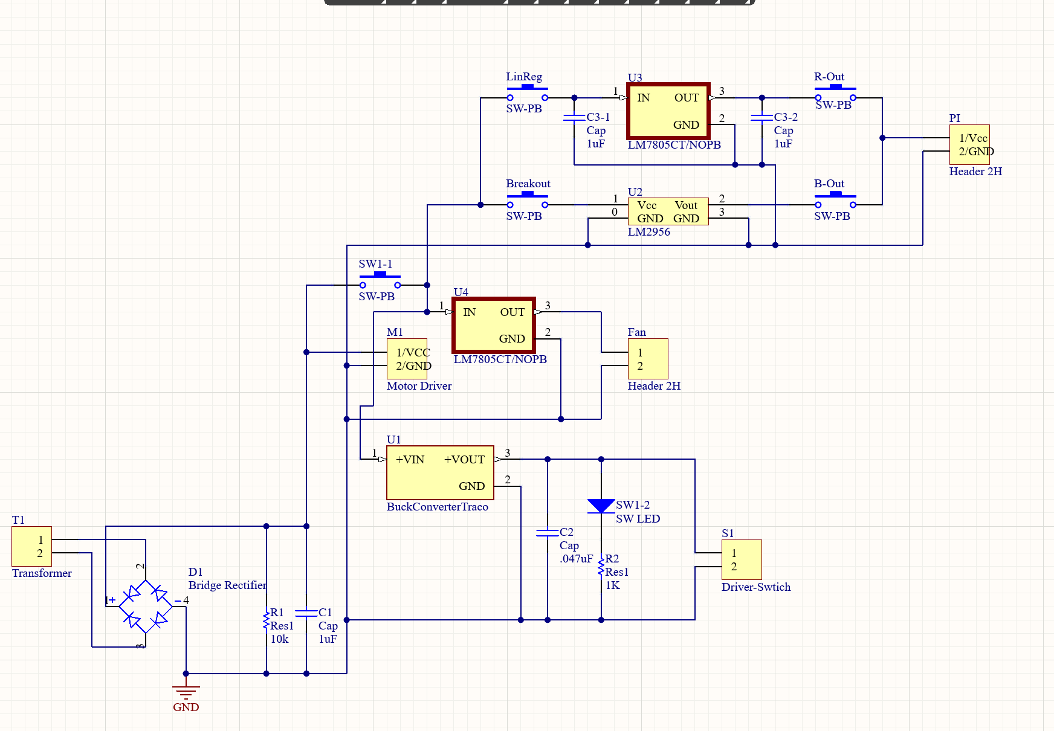
Circuit Diagram and Layout

Slide 9
Circuit Design
Raspberry Pi circuit
Involves a path for a DC-DC regulator and a buck converter: MIC29500-5.0WT and LM2956 Buck Converter.
LM2956 was chosen, and connected to finished design.
Vacuum Pump circuit
Vacuum Pump connected to Relay circuit.
This relay circuit is connected to larger relay circuit used for flipping cards.

Slide 10
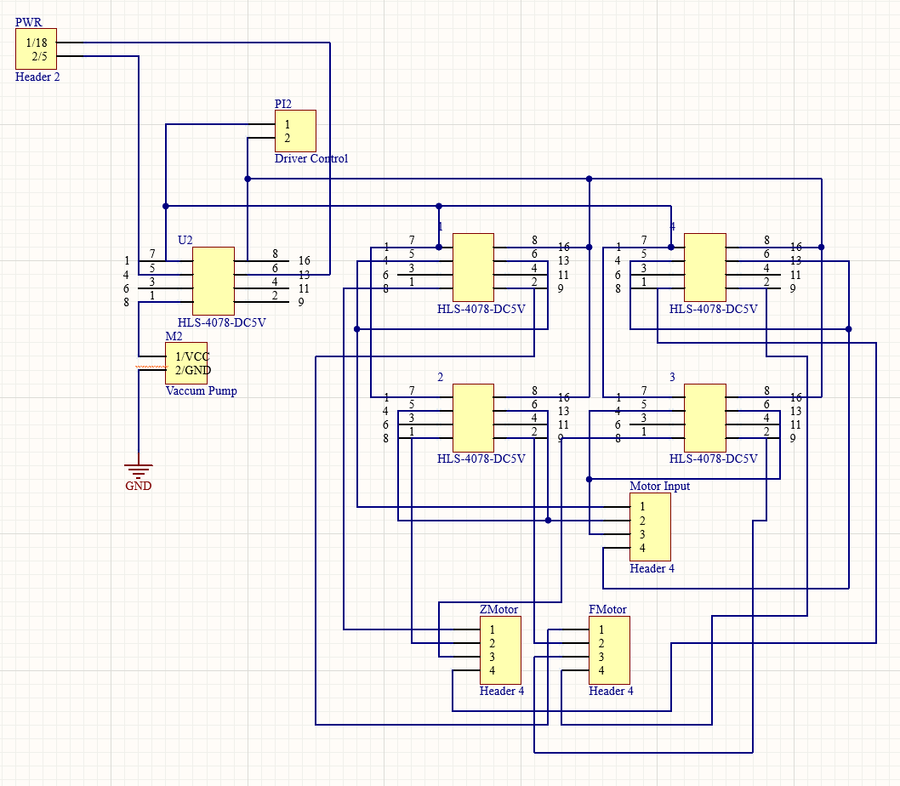
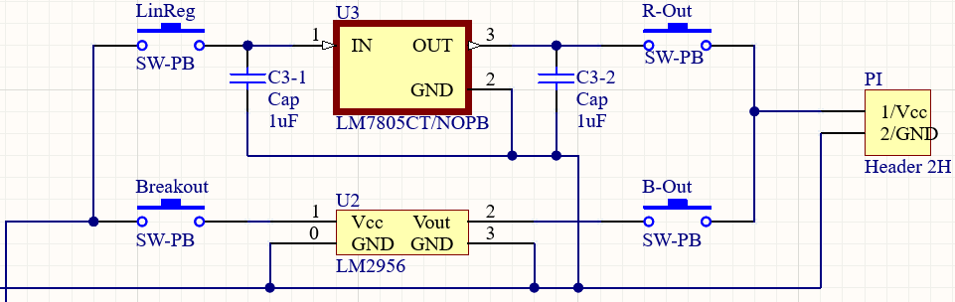
Circuit Design (Cont.)

Slide 11
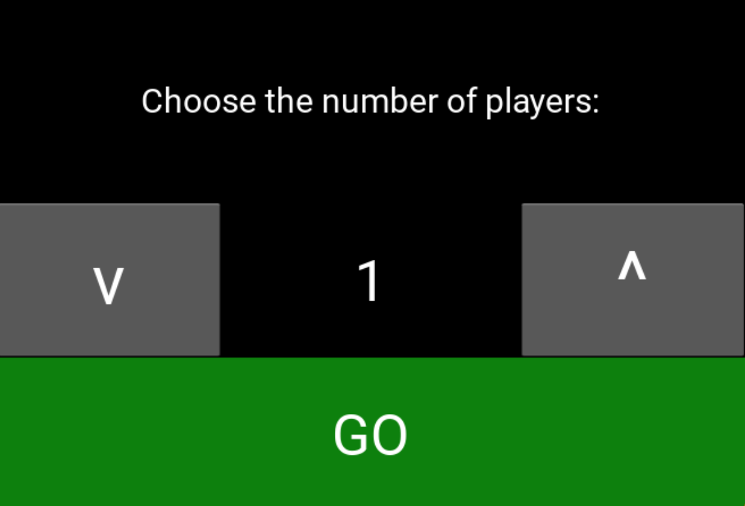
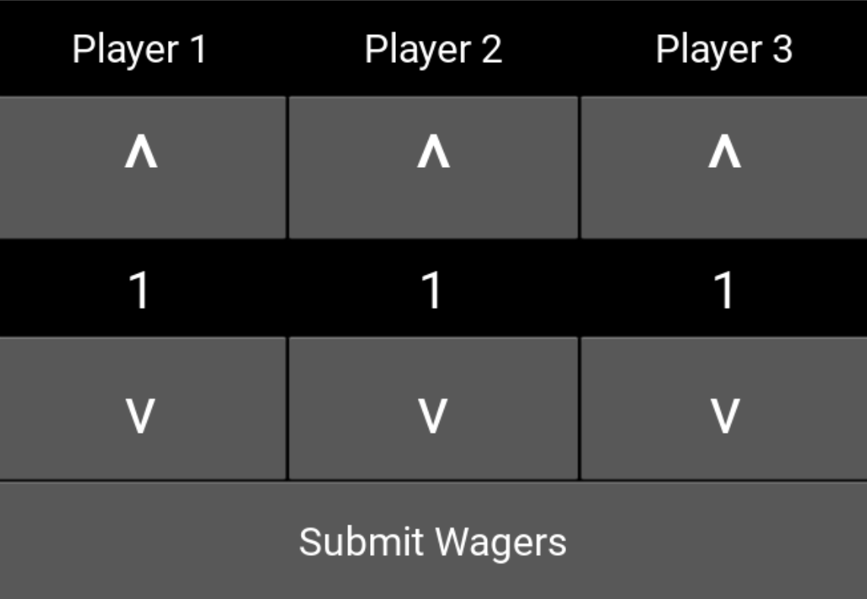
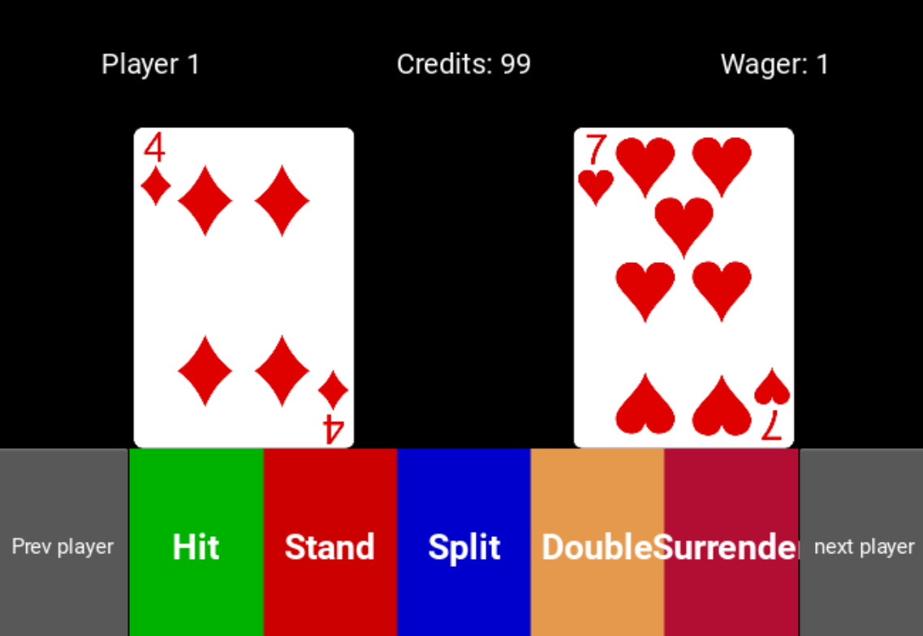
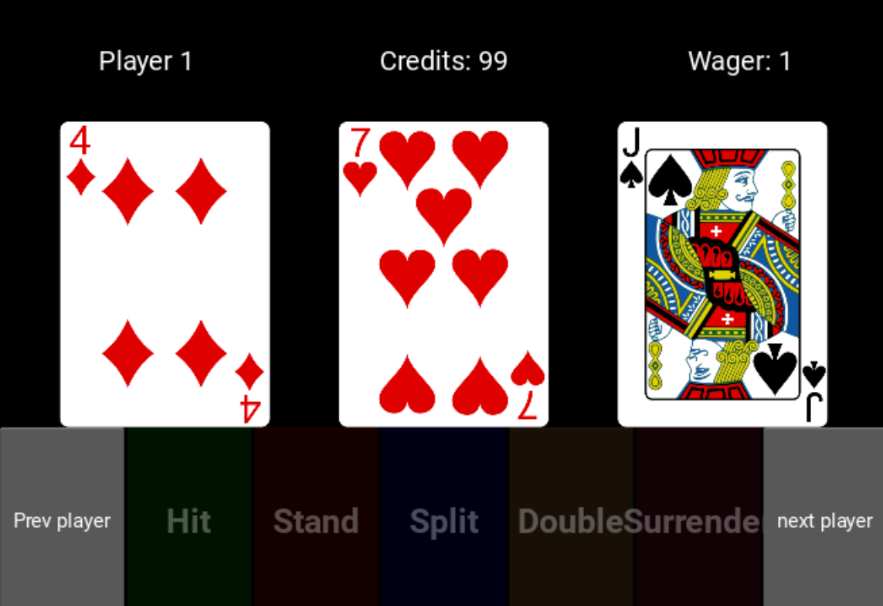
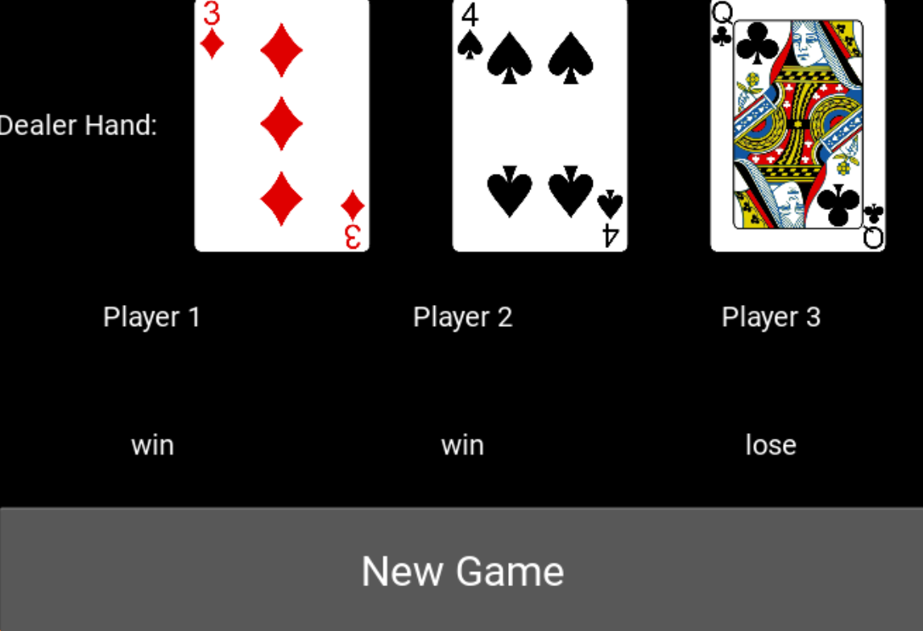
Playing the Game
Select the number of players
Each player sets a wager
Each player plays out their hand
Player actions are disabled once complete
Split hands are shown together but handled one at a time
Dealer’s hand is dealt and shown along with each player’s result
Proceeding to next game prompts for wagers again

Slide 12
How the Game Functions
Outstanding Issues
GUI built using Kivy library
All elements of the game are objects (e.g. Card(), Hand(), Player()
Coordinates are saved for every card and passed to Move() to physically move cards
Card objects are read in by the CV module
Status of players/hands saved with boolean flags
Aces are handled as 11s until forced into being counted as 1s
Players persist across repeat games
Kivy runs a main idle loop and only updates the visual GUI
Prevented me from auto-transitioning the player page
Agreed upon workaround is to keep the next/prev player buttons
Adding/removing players not added
Handling persistence across repeat games deemed too difficult with this included
We’ll have 3 players for the entire duration of the expo to demonstrate anyways
Insurance wagers may be a “game-time decision” for the expo
Wasn’t a part of minimum design and haven’t decided on how to visually incorporate it
Without flipping, I am entirely relying on players not moving cards too far from the coordinates I save

Slide 13
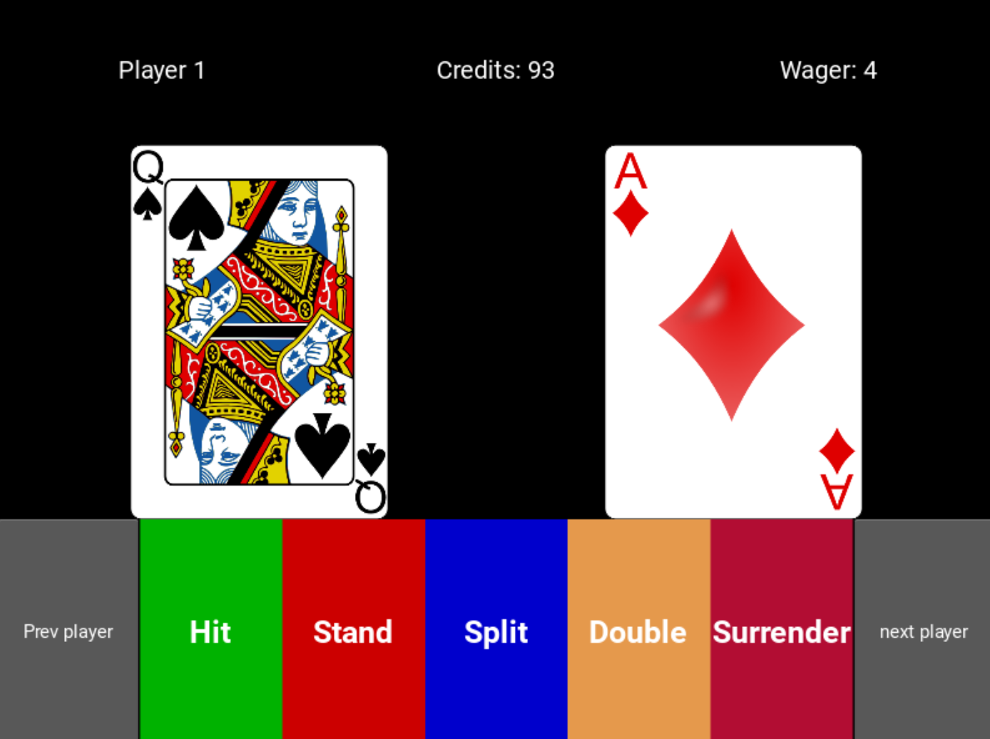
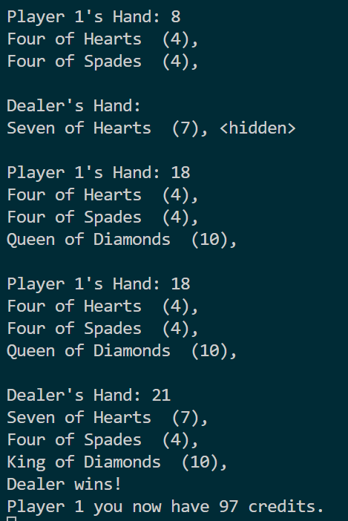
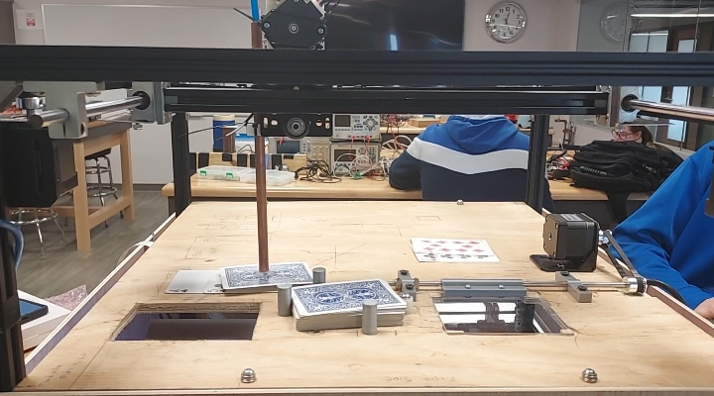
Game Logic Testing
Simple testing done to verify objects are handled correctly based on random cards (close right)
Smoke testing GUI inputs to find and solve presentation bugs (top right)
System integration testing to verify visually what is given to me by CV module and what is sent to Move module (bottom right)

Slide 14
How the Cards are Read
Utilizes OpenCV with the Raspberry Pi to capture card image
The image undergoes Gaussian graying and blurring, before using adaptive thresholding to draw the contours
Each contour is a different size, and the algorithm filters out each contour that does not match 1 of 3 qualifiers:
It must be a valid shape (diamond, heart, club, spade)
It must have a blue rectangular box (face cards)
It must have a single, significantly larger Spade (ace of spades)

Slide 15

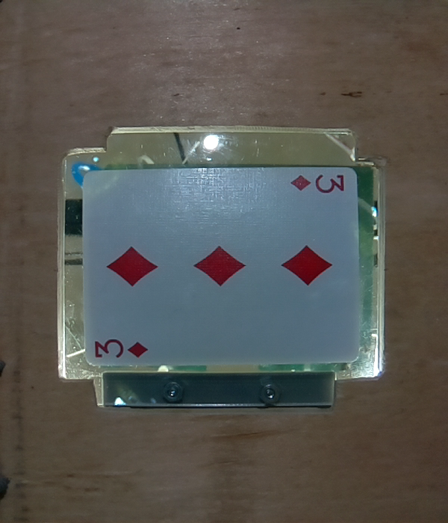
Numerical Cards
If the card does not have a blue border and it found shapes that match one of the four valid shapes, it is determined to be a numerical card
The number of valid shapes is counted and determines the value of the card
The size of the shape is compared to the sizes of the four suits, and the closest match is the predicted suit

Slide 16
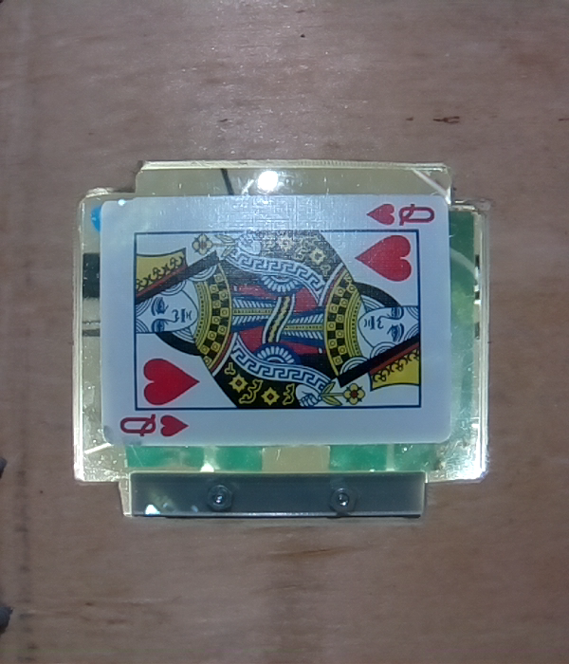
Face Cards
If the card does have a blue border, it must be a face card
The image is cropped so that only the corner of the card is visible
Contours are redrawn, and filtered to match either one of the four suit shapes, or one of the three letters (J for Jack, Q for Queen, K for King)
The area and perimeter of these shapes are compared to the expected values of the sizes for the expected shapes

Slide 17
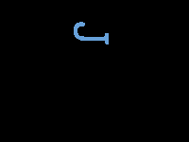
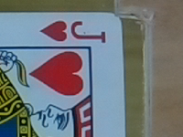

Face Cards
The blue border is identified, and the cropped image is produced. The J and the Heart are filtered out, identifying the card as the Jack of Hearts

Slide 18
Ace of Spades
The Ace of Spades is the only unique card in the Bicycle Standard Deck.
It has one massive Spade, where as the other three aces have one shape that is the same size as the other cards’.
A different filter is applied to extract the ace of spades, and if found, the card is predicted to be the ace of spades.

Slide 19
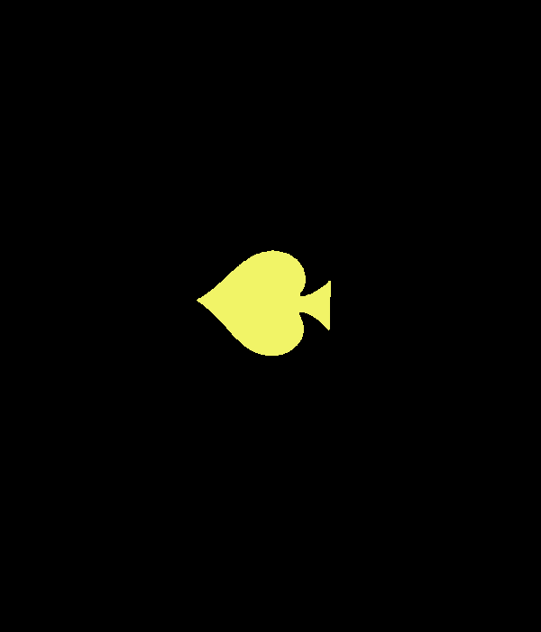
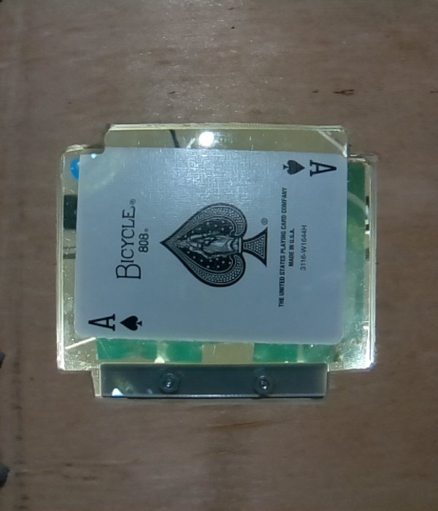
Ace of Spades

Slide 20
Testing
Requirement: >99% accuracy
It is vital that the accuracy of the point values for each card is 100%
Face cards have the same value, so at worst, a face card must be identified as a face card
Suit is irrelevant in blackjack, however, it was still part of the requirements to have an accuracy >99%
After several iterations of testing, we were able to run 100% accuracy through the deck several times in a row

Slide 21
Testing
Through testing, I encountered several miscalculations
The ace of spades was the biggest issue
Solved by adding a new filter for it specifically
The value from the face cards were difficult to extract
Moved from analyzing whole card to the top left corner
Biggest Setback was the lighting
Due to the nature of our setup, overhead lighting causes the white cards to blend in
Solved by adding overhead blocker
Underneath Lighting was an issue as well

Slide 22
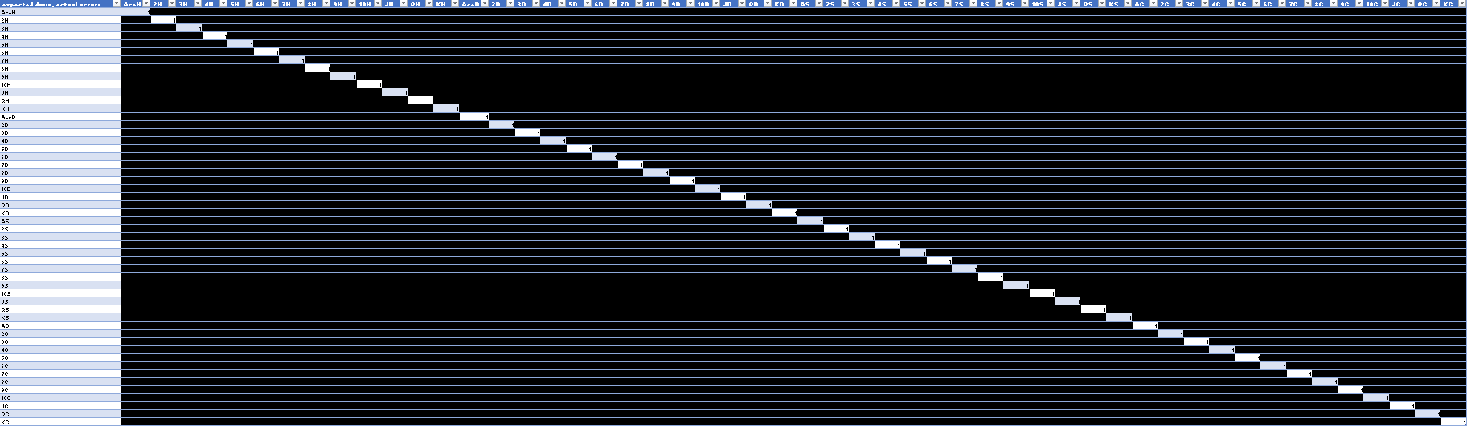
Testing

Slide 23
Runtime
Required runtime: less than 5 seconds
In 52 trials:
Maximum runtime:
2.22 seconds
Minimum runtime:
2.07 seconds
average runtime:
2.1225 seconds
No Specified required framerate
Framerate set to 608x704 pixels

Slide 24
Recap
We are fully integrated and functional.
Our metrics have, so far, all been met or surpassed.
To do until the expo:
Improve aesthetics
Finalize internal mounting
Secure power PCB
Get flipping functional if possible
Be prepared to recalibrate CV module for lighting

Slide 25
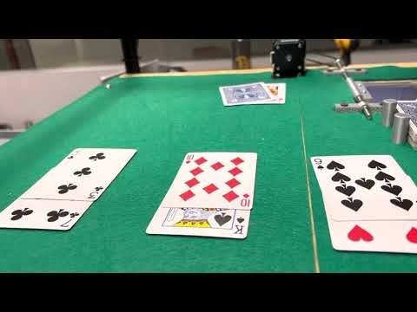
Demonstration

Slide 26
Questions??

